Slide 1
Cross-sectional Studies
Notes:
This week we’re discussing cross-sectional studies.

Slide 2
Measures
Observations
Experiments
Case
Descriptions
Ecological
Cross-sectional
Case-control
Cohort
Non-randomized
Randomized
Typically less convincing
Typically more convincing
Notes:
As you can see in the diagram on the screen, cross-sectional studies are another type of observational study. They are often considered to produce less convincing (or “weaker”) evidence than any of the study designs we’ve discussed so far. Having said, they definitely serve an important purpose in epidemiology. Before diving into the nuts and bolts of the cross-section study design, let’s do a quick check of what you guys remember from the readings.
** Socrative 1

Slide 3
Basic cohort study design
Outcome Measured
in Exposed
Cohort Identified
Exposure Measured
Incidence Proportion
Exposure Occurrence
Compare Incidence Proportion
Outcome Measured
in Unexposed
Incidence Proportion
Where:
Orange = Exposed
Blue = Unexposed
Circle = No Outcome
Triangle = Outcome
Time
Notes:
The defining characteristic of cross-sectional studies is that they simultaneously measure exposures and outcomes at a single point in time.
As a review, here’s my little graphical representation of the basic prospective cohort design. Remember that exposures that we are interested in occur out in the world, but the outcomes have not yet occurred. Then, we come along and measure these exposures and classify a group of people (a cohort) as exposed or unexposed. Then, we let some time pass and we see if more exposed people or more unexposed people develop the outcome(s) we are interested in.
Where:
Orange = Exposed to vaccine
Blue = Unexposed to vaccine
Circle = No Flu
Triangle = Flu

Slide 4
Basic case-based case-control study design
Population of interest
Cases Identified
Exposure Measured
Calculate Odds
Compare Odds
Controls Identified
Exposure Measured
Calculate Odds
Time
Notes:
Then, we talked about case-control studies.
In the basic case-based case-control study design, exposures and outcomes that we are interested in occur out in the world. Then, we come along and gather up a group of people who have already had the outcome we are interested in and then measure their history of exposures(s). Similarly, we gather up a group of people who we think are comparable to the people with the outcome in all relevant ways, but who haven’t had the outcome, and we also measure their history of exposure(s). Finally, we calculate the odds of being exposed in both groups and compare.
Example:
Orange = Exposed to smoking
Blue = Unexposed to smoking
Circle = No lung cancer
Triangle = Lung cancer

Slide 5
Basic cross-sectional study design
Sample Selected
Exposure Measured
and Outcome Measured
Population of Interest
Calculate Prevalence
Compare Prevalence
Calculate Prevalence
Time
Notes:
But, when we use a cross-sectional study design we simultaneously measure exposures and outcomes at a single point in time. So here, we have a population of interest were exposures and outcomes have occurred out in the world. We come along and take a sample of the population and measure the exposures and outcomes at the same time.
For example:
Orange = Exposed to hepatitis B virus
Blue = Unexposed to hepatitis B virus
Circle = No aplastic anemia
Triangle = Aplastic anemia
Let’s stop on notice a couple things here:
First, notice here that there is some ambiguity about which is the exposure and which is the outcome (or more precisely, which is the cause and which is the effect).
Second, notice that now we must use prevalence as our measure of disease occurrence.

Slide 6
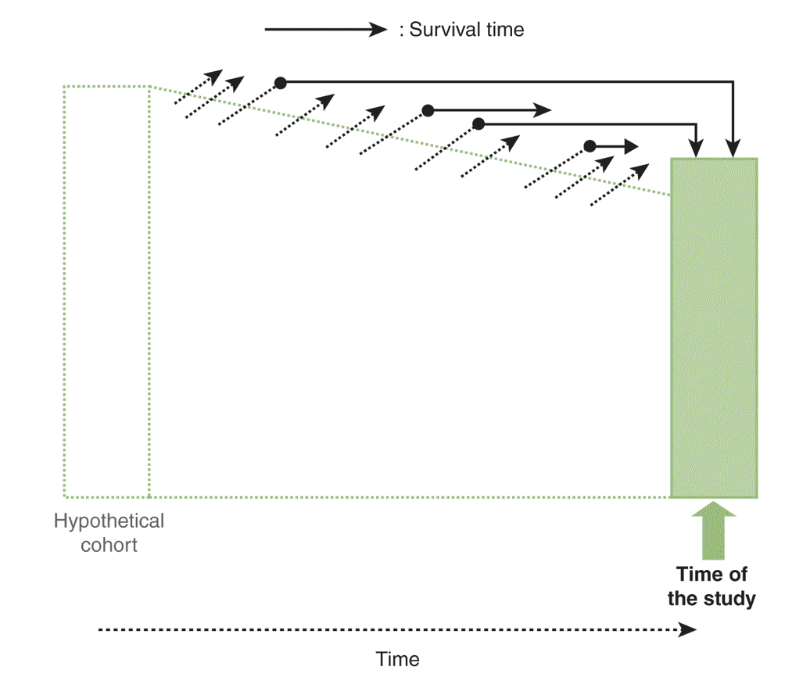
Notes:
Here is how the textbook represents it.
I also want you to notice a third thing here. I think it stands out a little more clearly in this graphic. By measuring prevalent cases (as opposed to incident cases) we are giving preference to people who survive longer with the outcome. Said another way, the ratio of people who get the outcome and die quickly to people who get the outcome and survive for a relatively long time may be different when we use a cross-sectional study design vs a cohort design.
** Socrative 2

Slide 7
Cross-sectional studies
Observational design
The basic idea
Select a sample of (or rarely all) participants from our population of interest.
Measure exposure(s) and outcome(s) at a single point in time.
The prevalence of exposure(s) are compared to the prevalence of outcome(s) at that specific point in time (usually).
When to Use
Ascertain prevalence of exposure(s) and disease(s) in population – public health planning and resource allocation.
Hypothesis generation and study planning.
Notes:
So, let’s pause here and do a quick recap.
Cross-sectional studies are a type of observational study design.
The basic idea is that we select a sample of participants from our population of interest, we measure exposure(s) and outcome(s) at a single point in time, and then the prevalence of exposure(s) are compared to the prevalence of outcome(s) at that specific point in time (usually).
Cross-sectional studies are a good choice when we want to ascertain prevalence of exposure(s) and disease(s) in population. For example, for public health planning and resource allocation. The cross-sectional study design can also be a good choice when our goal is hypothesis generation and study planning.

Slide 8
Measuring prevalence
 | Outcome + | Outcome - | Total
Exposure + | a | b | a + b
Exposure - | c | d | c + d
Total | a + c | b + d | n
The prevalence of outcome = (a + c) / n
The prevalence of exposure = (a + b) / n
Notes:
So far in this course we’ve primarily discussed incidence of outcomes. Now, let’s talk a little bit about prevalence, which is typically our measure of occurrence in cross-sectional studies.
As you can see in this 2x2 table, we can measure the prevalence of the outcome as (a + c) / n, and we can measure the prevalence of the exposure as (a + b) / n.

Slide 9
Measuring prevalence
 | MI + | MI - | Total
Smoking + | 592 | 1,589 | 2,181
Smoking - | 838 | 1,415 | 2,253
Total | 1,430 | 3,004 | 4,434
The prevalence of outcome = (a + c) / n
The prevalence of MI = 1,430 / 4,434 = 0.32
Interpretation: In this sample, 32% of participants reported ever having an MI.
The prevalence of exposure = (a + b) / n
The prevalence of Smoking = 2,181 / 4,434 = 0.49
Interpretation: In this sample, 49% of participants reported current smoking.
Notes:
For example, in this 2x2 table we are investigating the relationship between smoking and MI. Notice that the labels “outcome” and “exposure” are set by us. There may or may not be any valid justification for which is which.
In this table, the prevalence of the outcome, MI, is 0.32. We could interpret the prevalence by saying, “In this sample, 32% of participants reported ever having an MI.”
Further, the prevalence of the exposure, smoking, is 0.49. We could interpret the prevalence by saying, “In this sample, 49% of participants reported current smoking.”

Slide 10
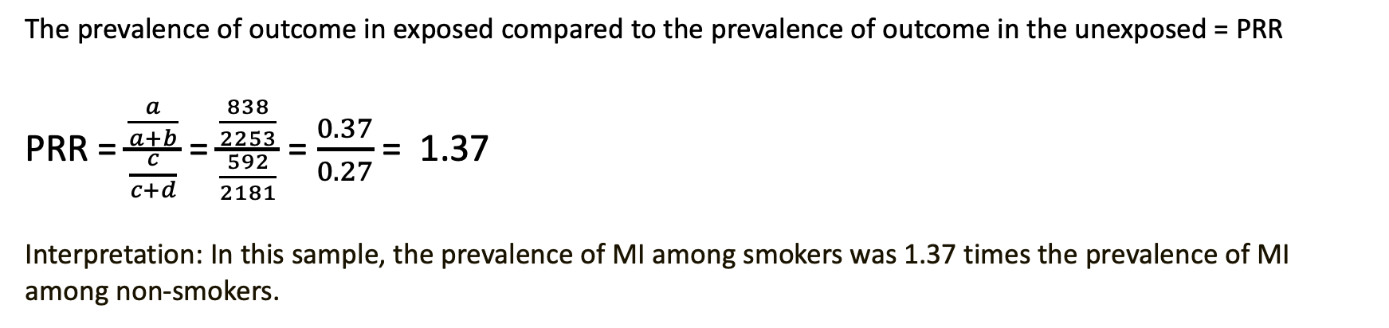
Prevalence (rate) ratio
 | MI + | MI - | Total
Smoking + | 838 | 1,415 | 2,253
Smoking - | 592 | 1,589 | 2,181
Total | 1,430 | 3,004 | 4,434
The prevalence of outcome in exposed compared to the prevalence of outcome in the unexposed = PRR
PRR = $\frac{\frac{a}{a+b}}{\frac{c}{c+d}}$ = $\frac{\frac{838}{2253}}{\frac{592}{2181}}$ = $\frac{0.37}{0.27}$ = 1.37
Interpretation: In this sample, the prevalence of MI among smokers was 1.37 times the prevalence of MI among non-smokers.
Notes:
We have two measure of association to choose from when we want to compare prevalence in our cross-sectional data.
First, we can calculate the prevalence rate ratio using the formula you see on the slide here. It’s identical to the formula we learned for calculating a risk ratio. The big difference is that our 2x2 table now contains prevalent cases of the outcome instead of incident cases of the outcome and that will affect our interpretation.
In this case, we can interpret the PRR of 1.37 by saying, “In this sample, the prevalence of MI among smokers was 1.37 times the prevalence of MI among non-smokers.”

Slide 11
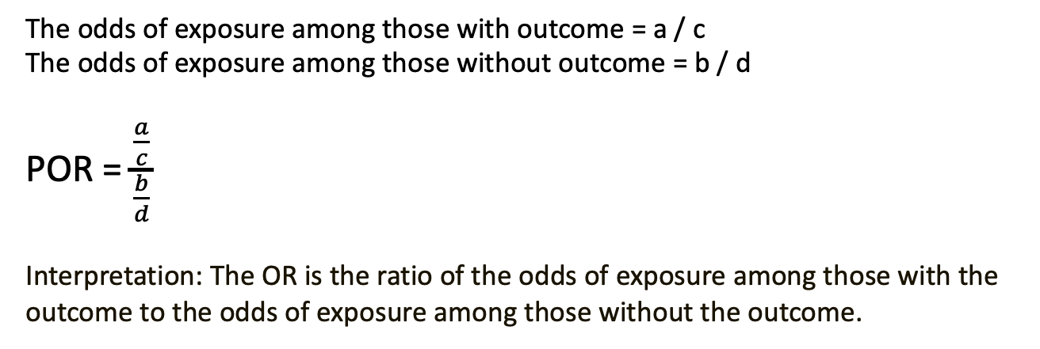
Prevalence odds ratio
 | Outcome + | Outcome -
Exposure + | a | b
Exposure - | c | d
 | Odds = a / c | Odds = b / d
The odds of exposure among those with outcome = a / c
The odds of exposure among those without outcome = b / d
POR = $\frac{\frac{a}{c}}{\frac{b}{d}}$
Interpretation: The OR is the ratio of the odds of exposure among those with the outcome to the odds of exposure among those without the outcome.
Notes:
The other measure of association available to us is the prevalence odds ratio (often just called odds ratio). Again, this odds ratio is calculated using the same formula we’ve been using all semester to calculate and odds ratio. The big difference is that our 2x2 table now contains prevalent cases of the outcome instead of incident cases of the outcome and that will affect our interpretation.

Slide 12
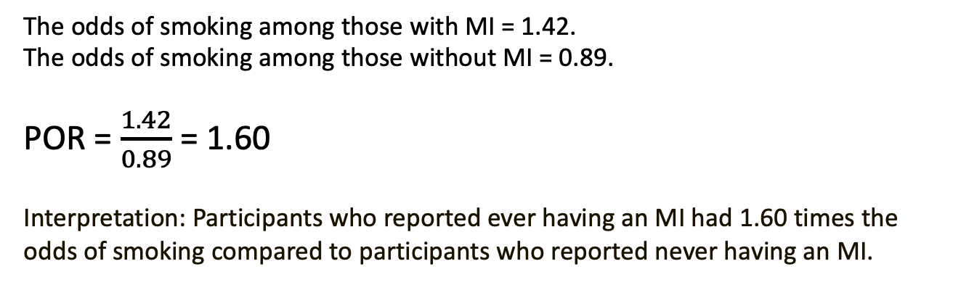
Prevalence odds ratio
 | MI + | MI -
Smoking + | 838 | 1,415
Smoking - | 592 | 1,589
 | Odds = 1.42 | Odds = 0.89
The odds of smoking among those with MI = 1.42.
The odds of smoking among those without MI = 0.89.
POR = $\frac{1.42}{0.89}$ = 1.60
Interpretation: Participants who reported ever having an MI had 1.60 times the odds of smoking compared to participants who reported never having an MI.
Notes:
Here’s an example.
The odds of smoking among those with MI is 1.42 or 142 to 100. In words, we could say that among people who ever had an MI there were 142 people who smoked for every 100 people who didn’t smoke.
Similarly, the odds of smoking among those without MI is 0.89 or 89 to 100. In words, we could say that among people who have not yet ever had an MI there were 89 people who smoke for every 100 people who didn’t smoke.
We could then calculate the prevalence odds ratio as:
POR = $\frac{1.42}{0.89}$ = 1.60
We could interpret this result by saying, “Participants who reported ever having an MI had 1.6 times the odds of smoking compared to participants who reported never having an MI.”
Like all OR’s, POR’s are symmetric. So, the odds ratio association between smoking and MI is equal to the odds ratio association between MI and smoking.
Another convenient feature of the prevalence odds ratio is that it can be derived from a logistic regression model.

Slide 13
Measure
Truth
Error
People are randomly different in sample and population
Systematic
People are systematically different in sample and population
Systematic errors in the way we collect data
Systematic associations that are non-causal
Notes:
Like all study designs, cross-sectional studies are susceptible to bias. In addition to many of the forms of bias we have already discussed this semester, there is one form of selection bias and one form of information bias that we should be especially cognizant of in the context of cross-sectionals studies. As a reminder, selection bias occurs when people are systematically different in the sample and the population, and information bias occurs when there are systematic errors in the way our data is collected.

Slide 14
Incidence-prevalence bias
Introduced when using prevalence to estimate incidence (risk)
Duration of disease is affected by exposure (survival bias)
Prevalence is high
Notes:
Incidence-prevalence bias is a form of selection bias. It occurs when we use prevalence to estimate incidence (or risk). This happens when the duration of disease is affected by the exposure (i.e., survival bias) or when the prevalence is high.

Slide 15
Notes:
Again, by measuring prevalent cases (as opposed to incident cases) we are giving preference to people who survive longer with the outcome. Said another way, the ratio of people who get the outcome and die quickly to people who get the outcome and survive for a relatively long time may be different when we use a cross-sectional study design vs a cohort design.
As you can see here, the people who make it into our cross-sectional study are different than the people who would have made it into our cohort study and represent a different outcome experience than the experience we would have measured in our population. If those differences are meaningfully related to our exposures of interest, then we will likely draw different occlusions about our outcome (at least risk) than if we had used a cohort study design.

Slide 16
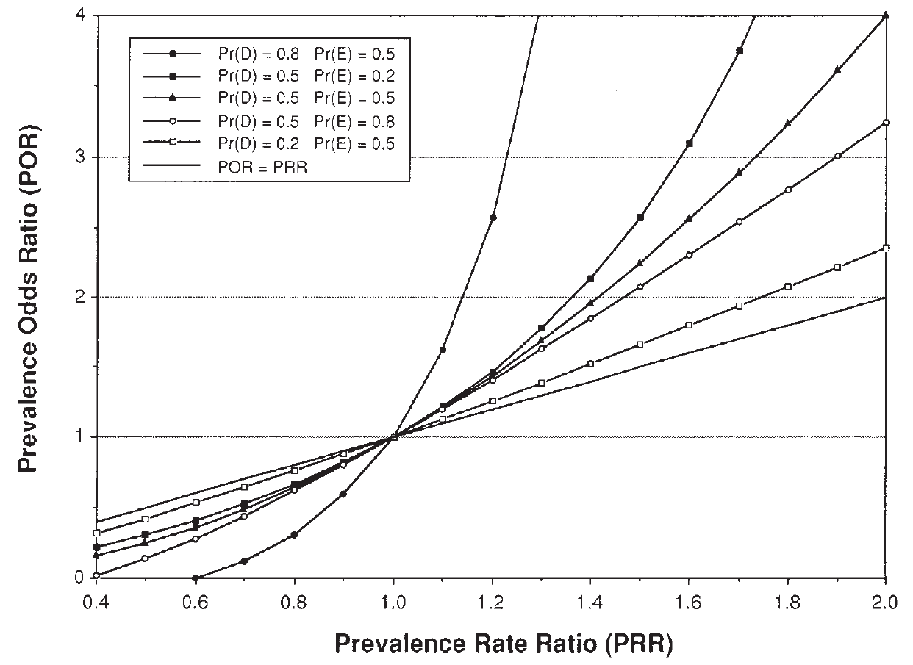
PR vs. POR in practice
PR is preferred when:
Duration of disease may be influenced by exposure
Prevalence of disease is high
POR is preferred when:
When disease is rare (Pr(D) < 0.10) POR approximates the PR and POR may be easier to estimate
Source: Zocchetti et al. Intl J Epi (1997) 26: 220-223
Notes:
Also, as you can see in this slide from a simulation study, the differences between PR’s and POR’s can be strongly impacted by the prevalence of the outcome. The exact numbers aren’t important here, this is just to give you a visual representation of how prevalence affects our estimates.

Slide 17
Temporal bias
Sample Selected
Exposure Measured
and Outcome Measured
Population of Interest
Calculate Prevalence
Compare Prevalence
Calculate Prevalence
Time
Notes:
The second form of bias that is particularly troublesome in cross-sectional studies is temporal bias – a form of information bias.
Because we are measuring exposure and outcome at the same time, there is often ambiguity about which is the exposure and which is the outcome, or which is the cause and which is the effect.
This is also sometimes called reverse causality.
Despite the possibility for these, and other, forms of bias, the cross-sectional study design remains a staple of epidemiology.
** Socrative 3 and 4.

Slide 18
Limitations
Difficult to establish temporal sequencing between exposure and disease and therefore causality
Limited to studying prevalent cases
Accurate recollection of exposure/disease by participants weighted towards recently exposed or ill
Not suitable for studying diseases: rare, highly fatal or with short duration
Notes:
In summary, cross-sectional studies definitely have an important role to play in epidemiology. Nearly all of the large, national surveys like the BRFSS and NHANES use a cross-sectional study design. However, cross-sectional studies also have a number of potential limitations that we need to be aware of as we are drawing our conclusions.
It can be difficult to establish temporal sequencing between exposure and disease and therefore causality.
We are limited to studying prevalent cases.
The accurate recollection of exposure/disease by participants is weighted towards recently exposed or recently ill.
And, cross-sectional studies are not suitable for studying diseases that are rare, highly fatal, or with a short duration.

